Slide 1
Week 2b
COMPUTATIONAL MATHEMATICS

Slide 2
Outline
Subplotting
Error bars
Other 2D plots
Histogram and Binnings

Slide 3
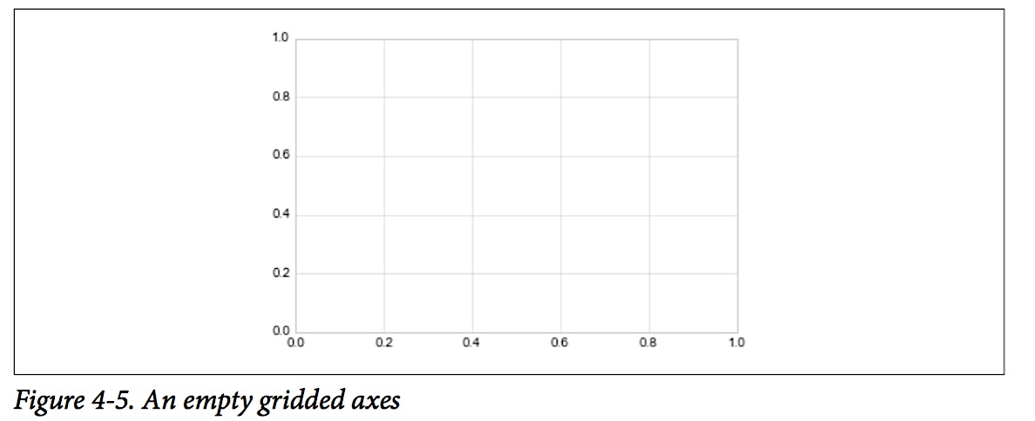
Figure and Axes
The figure (an instance of the class plt.Figure) can be thought of as a single container that contains all the objects representing axes, graphics, text, and labels.
The axes (an instance of the class plt.Axes) is what we see above: a bounding box with ticks and labels, which will eventually contain the plot elements that make up our visualization
This is what you think of as 'a plot', it is the region of the image with the data space.

Slide 4
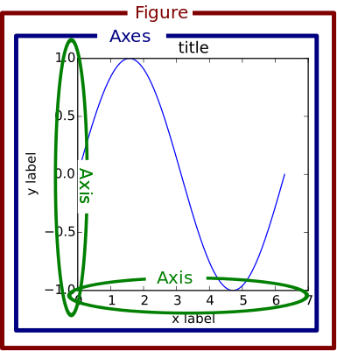
Figure and Axes

Slide 5
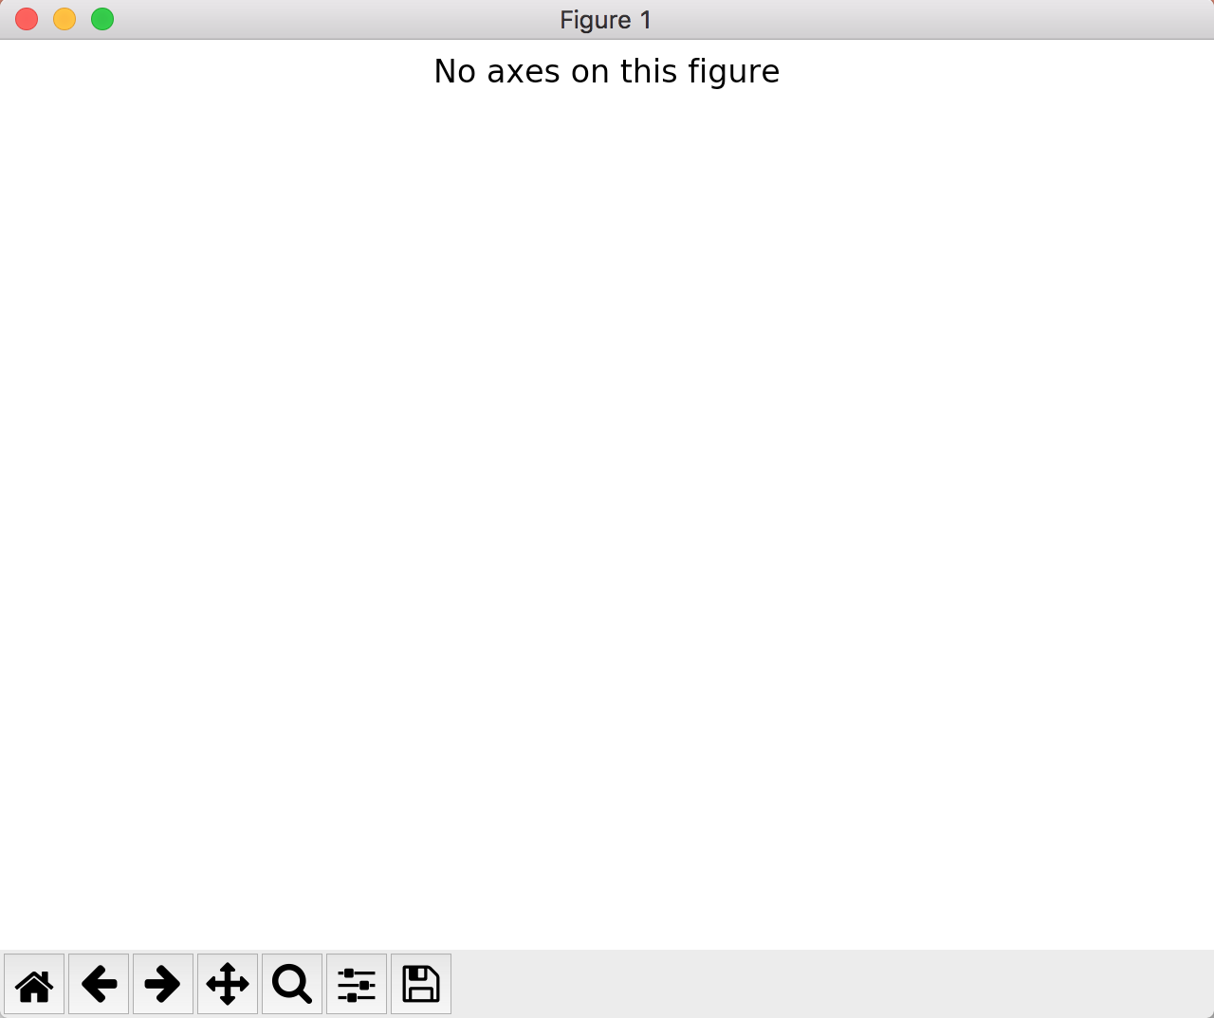
Add Figure to Create Canvas
Python Codes
Results
>> fig = plt.figure()
>> fig.suptitle('No axes on this figure')
#if you are using static mode
>> plt.show()
Create an empty figure with no axes

Slide 6
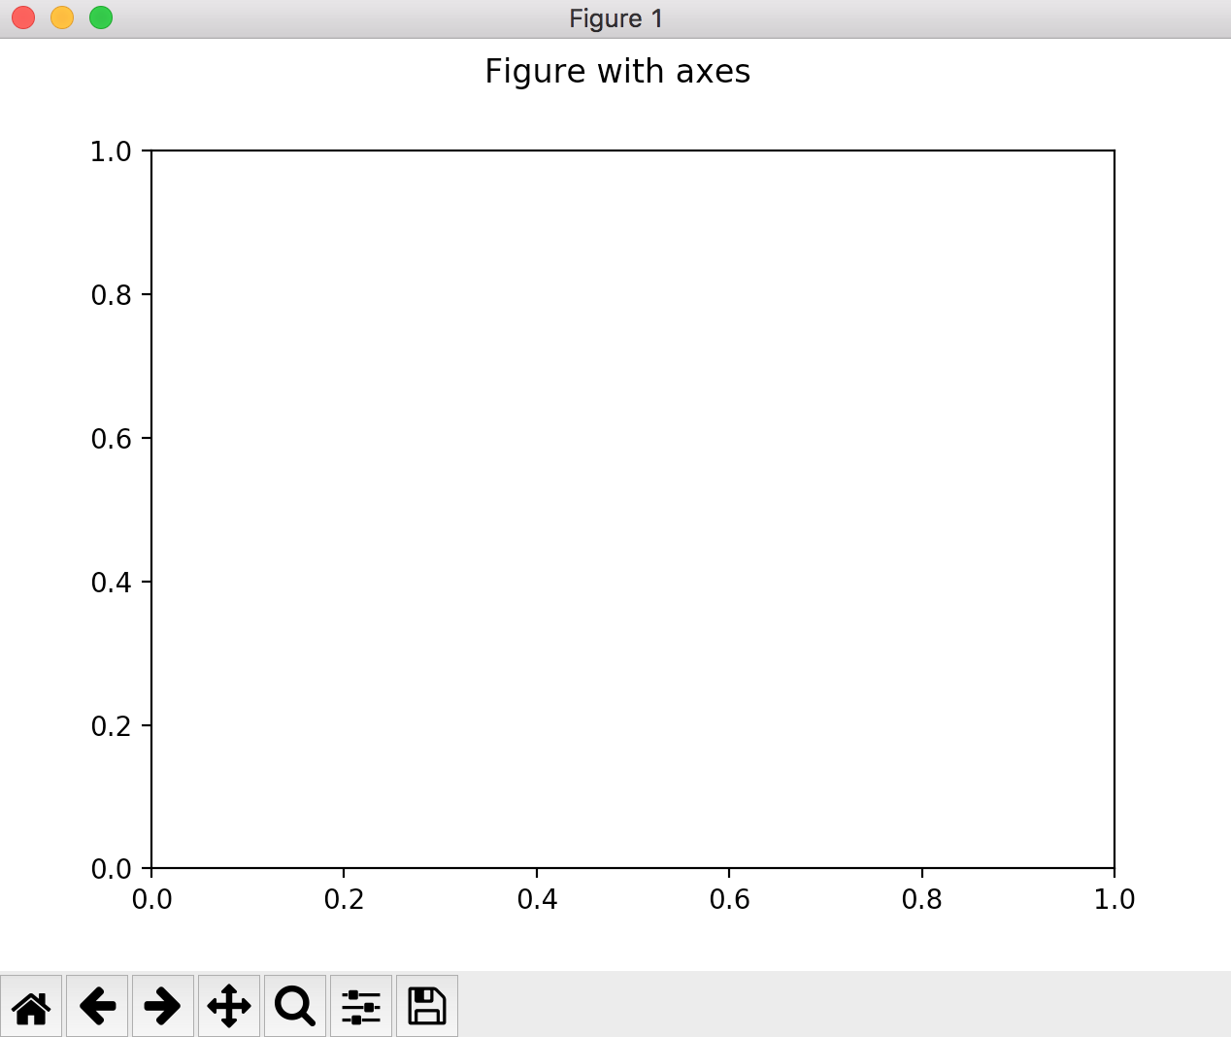
Add Axes to Canvas on Default Location
Python Codes
Results
>> fig = plt.figure()
>> ax = plt.axes()
>> fig.suptitle(’Figure with axes')
# if you are using static mode, don’t forget to use show()
>> plt.show()
Create a figure with axes

Slide 7
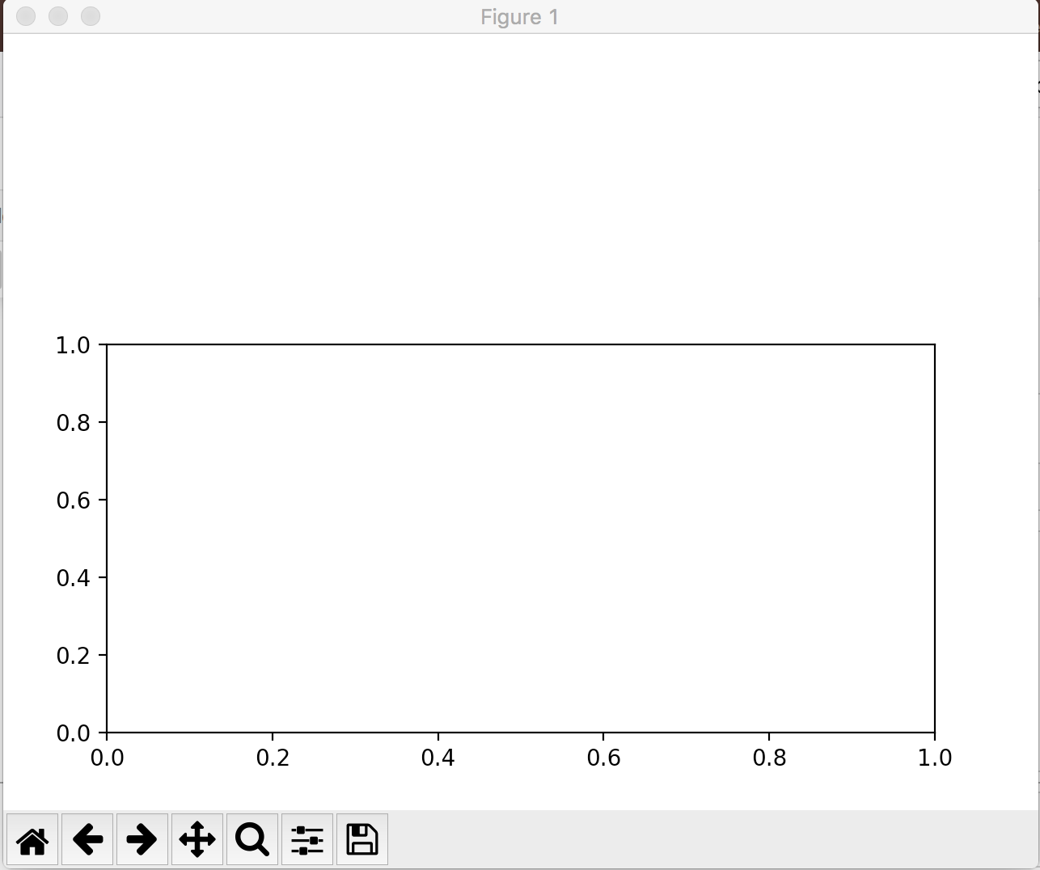
Add Axes to Canvas on Any location
Python Codes
Results
>> fig = plt.figure()
>> ax = plt.axes([0.1,0.1,0.8,0.5])
# ([left, bottom, width, height])
Create a figure with axes on location:
0.1 from left, 0.1 from bottom, 0.8 width, 0.5 height

Slide 8
Plotting Multiple Axes in a Canvas
Don’t get confused
subplots():
This is a function in pyplot
This method creates the figure along with the subplots that are then stored in the ax array.
returns a tuple fig, ax which is unpacked in two variables
subplot():
Add a subplot to the specific location on the current figure .

Slide 9
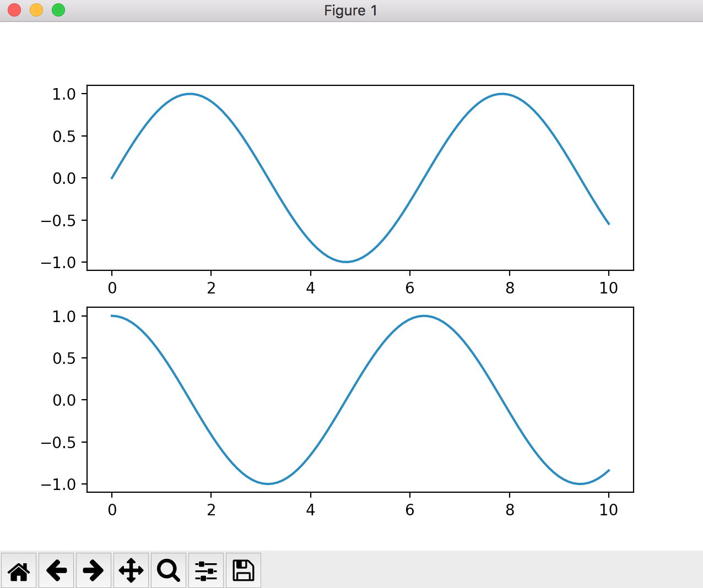
subplots()
Python Codes
Results
>> import numpy as np >> x = np.linspace(0, 10, 100)
# First create a grid of plots # ax will be an array of two Axes objects
>> fig, ax = plt.subplots(2)
# Call plot() method on the appropriate object
>> ax[0].plot(x, np.sin(x))
>> ax[1].plot(x, np.cos(x))

Slide 10
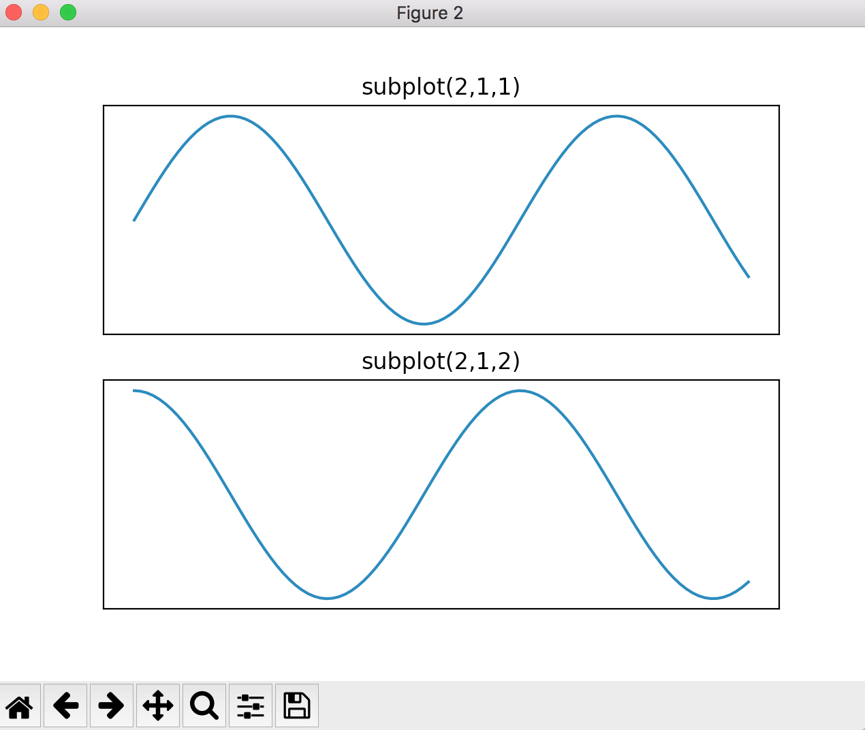
subplot ()
Python Codes
Results
import numpy as np x = np.linspace(0, 10, 100)
# create the first of two panels and set current axis
plt.subplot(2, 1, 1) # (rows, columns, panel number)
plt.plot(x, np.sin(x))
plt.xticks([]), plt.yticks([]) # clear ticks
plt.title('subplot(2,1,1)')
# create the second panel and set current axis
plt.subplot(2, 1, 2)
plt.plot(x, np.cos(x))
plt.xticks([]), plt.yticks([]) # clear ticks
plt.title('subplot(2,1,2)')

Slide 11
subplot ()
Python Codes
Results
import numpy as np x = np.linspace(0, 10, 100)
# create the first of two panels and set current axis
plt.subplot(2, 1, 1) # (rows, columns, panel number)
plt.plot(x, np.sin(x))
plt.xticks([]), plt.yticks([]) # clear ticks
plt.title('subplot(2,1,1)')
# create the second panel and set current axis
plt.subplot(2, 1, 2)
plt.plot(x, np.cos(x))
plt.xticks([]), plt.yticks([]) # clear ticks
plt.title('subplot(2,1,2)')
We can also share the axes between the subplots … (next slide)

Slide 12
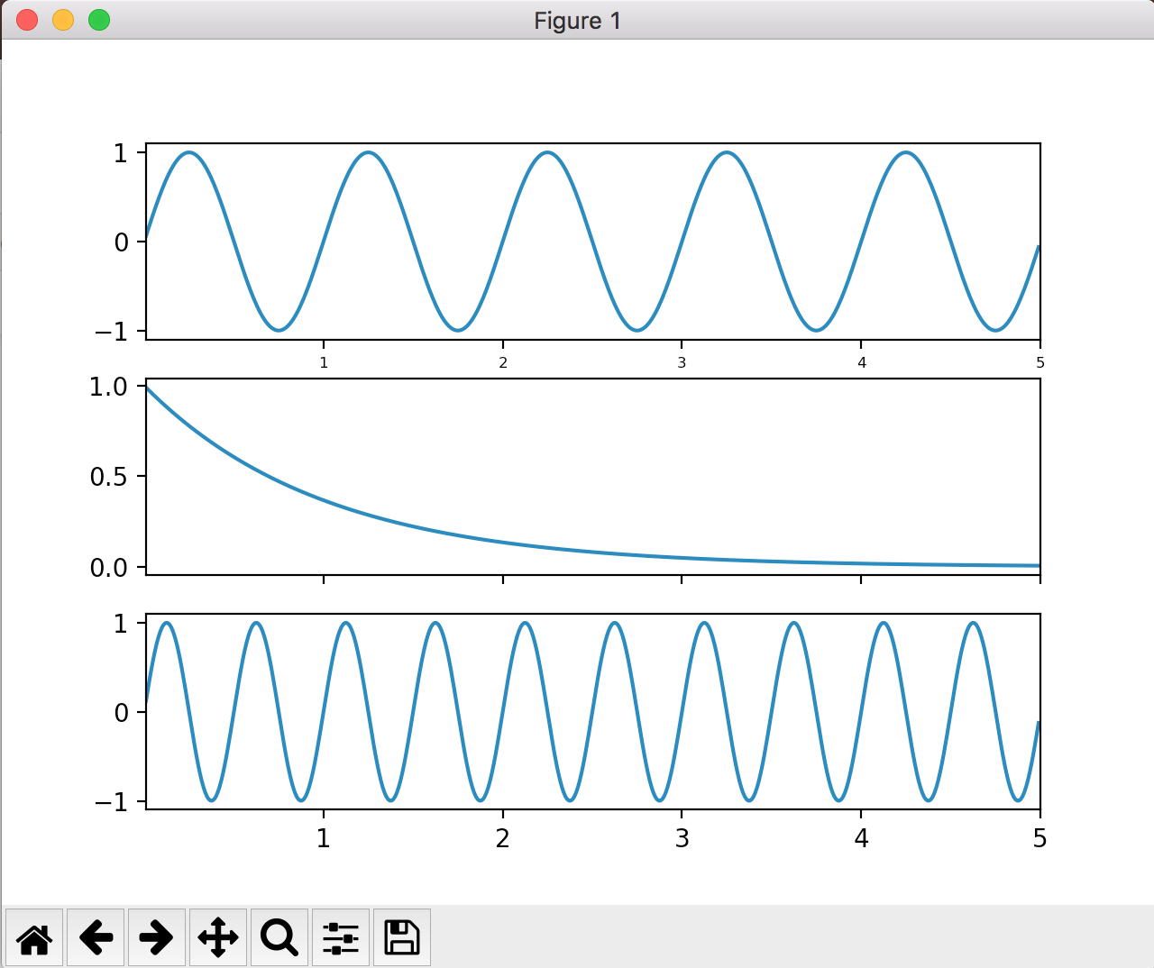
subplot ()
Python Codes
Results
import numpy as np
t = np.arange(0.01, 5.0, 0.01)
s1 = np.sin(2 * np.pi * t)
s2 = np.exp(-t)
s3 = np.sin(4 * np.pi * t)
ax1 = plt.subplot(3,1,1)
plt.plot(t, s1)
# share x only
ax2 = plt.subplot(3,1,2, sharex=ax1)
plt.plot(t, s2)
# share x and y
ax3 = plt.subplot(3,1,3, sharex=ax1, sharey=ax1)
plt.plot(t, s3)

Slide 13
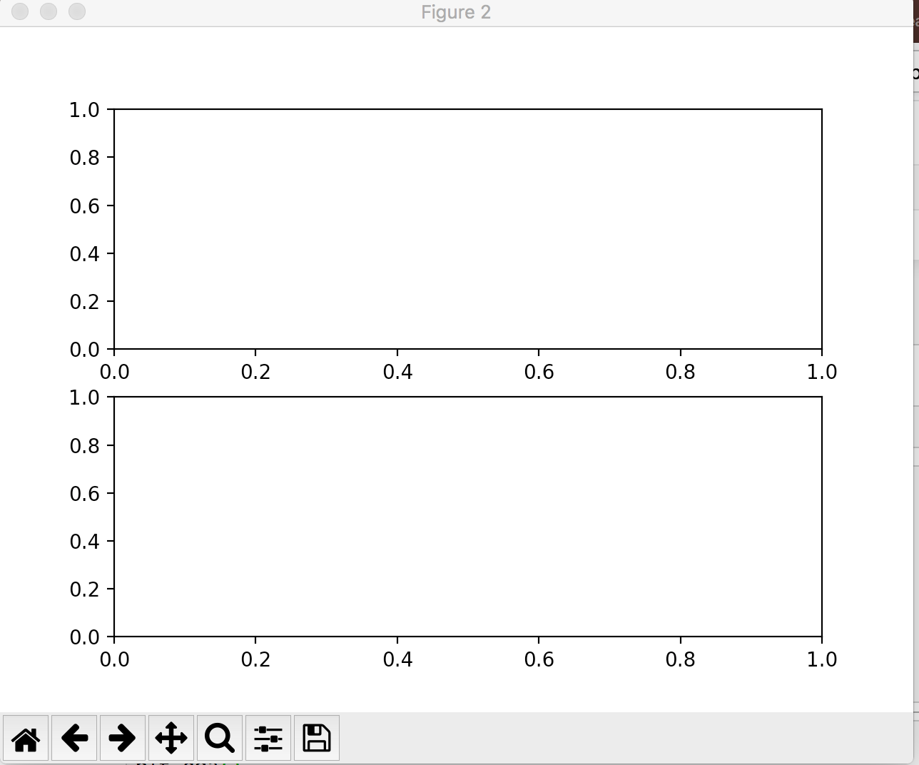
add_subplot()
Python Codes
Results
fig = plt.figure()
ax1 = fig.add_subplot(2,1,1)
ax2 = fig.add_subplot(2,1,2)
We can also use add_subplot from the figure to create subplot

Slide 14
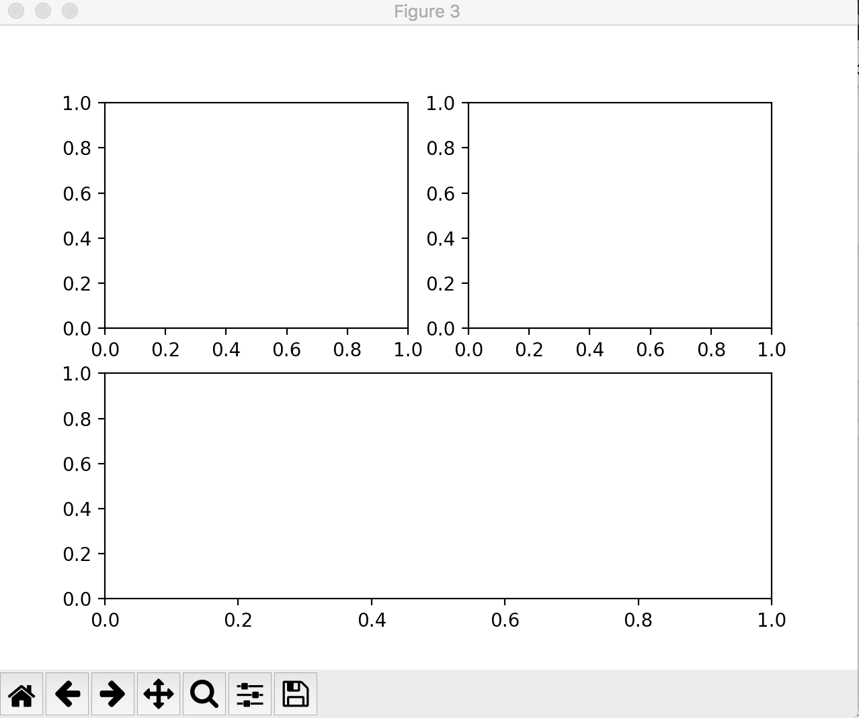
add_subplot()
Python Codes
Results
ax1
ax2
fig = plt.figure()
ax1 = fig.add_subplot(2,2,1) # (rows, columns, panel number)
ax2 = fig.add_subplot(2,2,2)
ax3 = fig.add_subplot(2,1,2)
We can combine the grid of the subplot using fig.add_subplot()
Or just use plt.subplot()
ax3

Slide 15
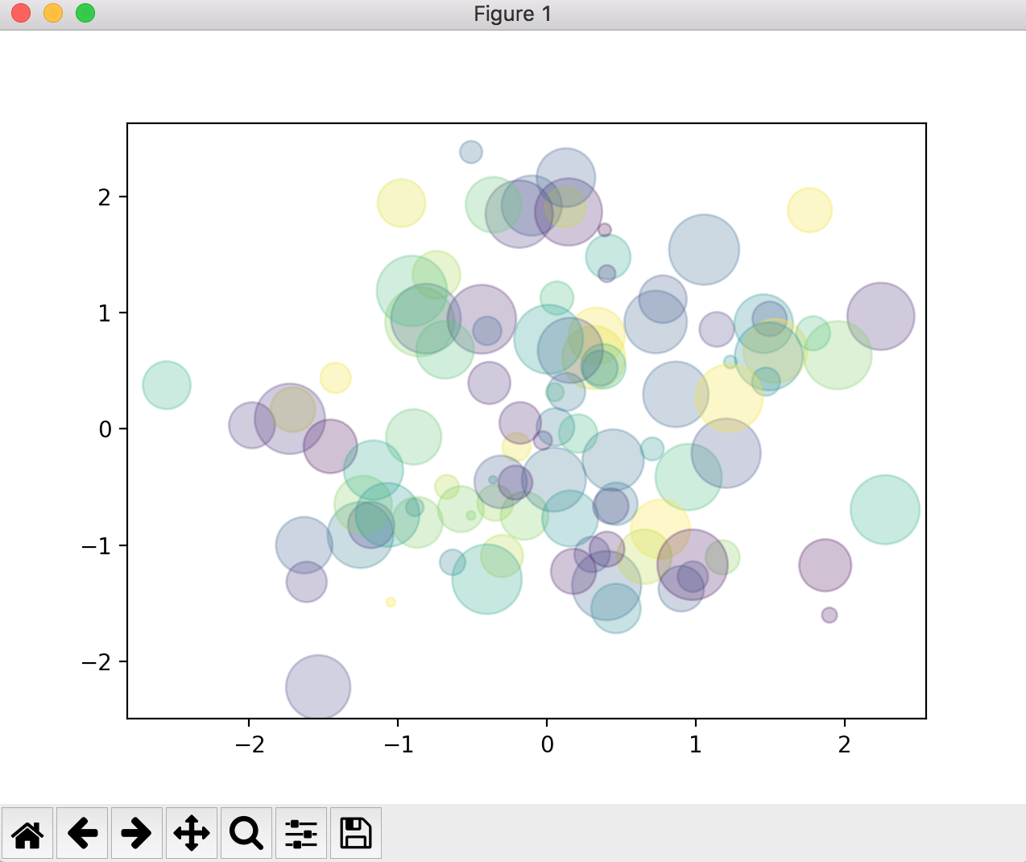
Other 2D pyplot styles: plt.scatter()
A scatter plot is a type of plot that shows the data as a collection of points. The position of a point depends on its two-dimensional value, where each value is a position on either the horizontal or vertical dimension.
Python Codes
Results
rng = np.random.RandomState(0)
x = rng.randn(100)
y = rng.randn(100)
colors = rng.rand(100)
sizes = 1000 * rng.rand(100)
plt.scatter(x, y, c=colors, s=sizes, alpha=0.3, cmap='viridis')
Notice that the color argument is automatically mapped to a color scale. Cmap argument is for colormaps, see https://matplotlib.org/3.1.1/tutorials/colors/colormaps.html

Slide 16
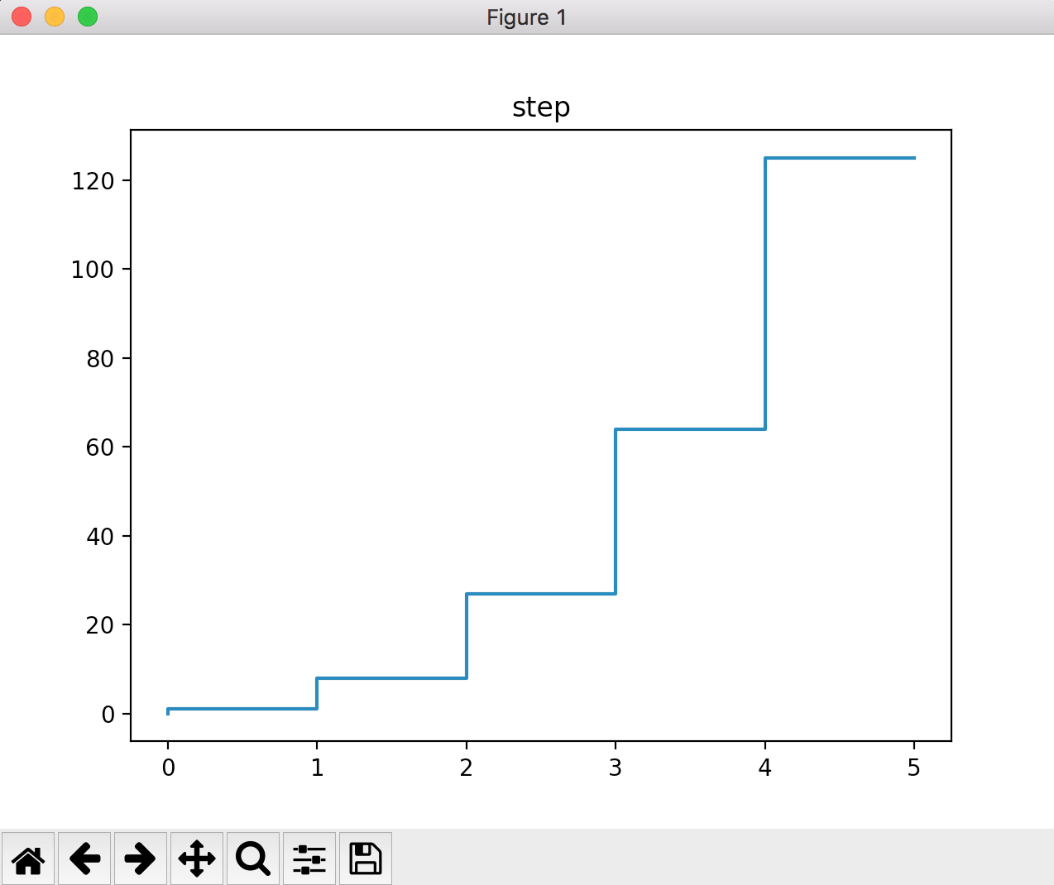
Other 2D pyplot styles: plt.step()
A step chart is a line chart that uses vertical and horizontal lines to connect the data points in a series forming a step-like progression.
Python Codes
Results
import numpy as np
n = np.array([0,1,2,3,4,5])
plt.step(n, n**3)
plt.title("step")

Slide 17
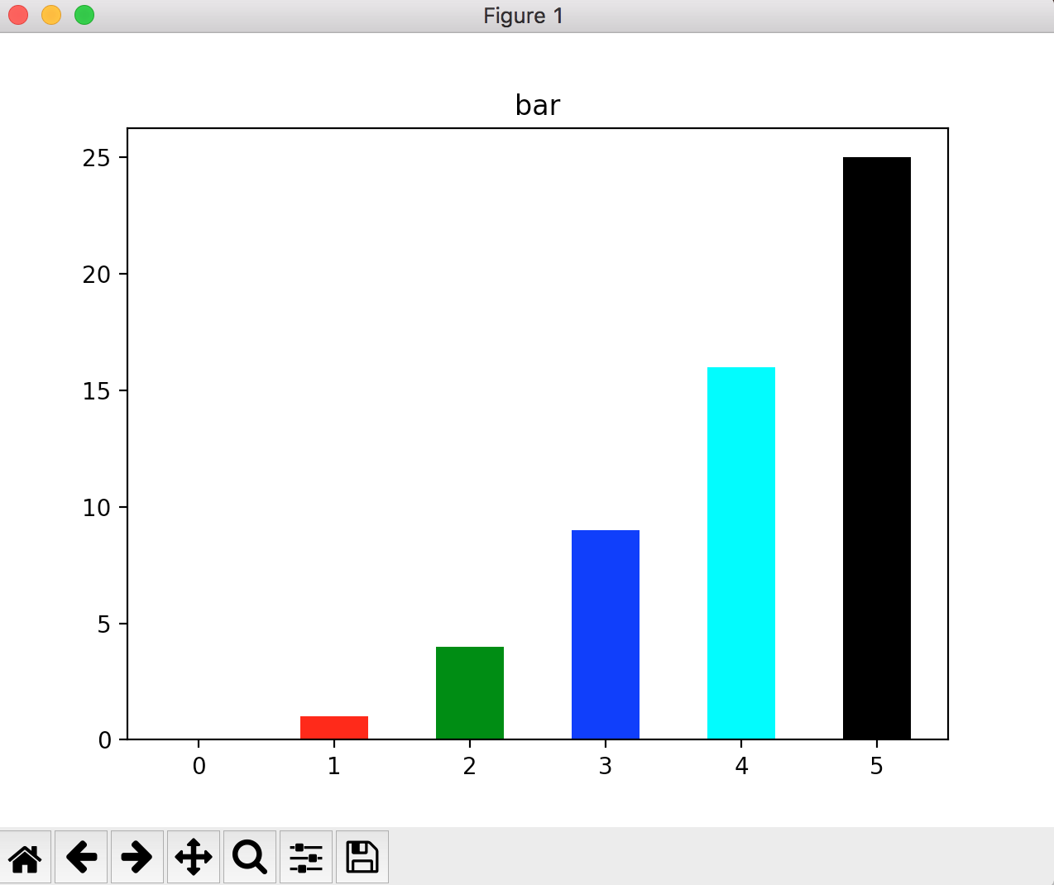
Other 2D pyplot styles: plt.bar()
A bar chart is a chart that presents categorical data with rectangular bars with heights or lengths proportional to the values that they represent.
Python Codes
Results
import numpy as np
n = np.array([0,1,2,3,4,5])
plt.bar(n, n**2, width=0.5, color=['k','r','g','b','c','k'])
plt.title("bar")

Slide 18
Histogram and Binnings
Histograms
It is similar to a Bar chart, but a histogram groups numbers into ranges .
It divides the variable into bins, counts the data points in each bin, and shows the bins on the x-axis and the counts on the y-axis.
The binwidth is the most important parameter for a histogram and we should always try out a few different values of binwidth to select the best one for our data.

Slide 19
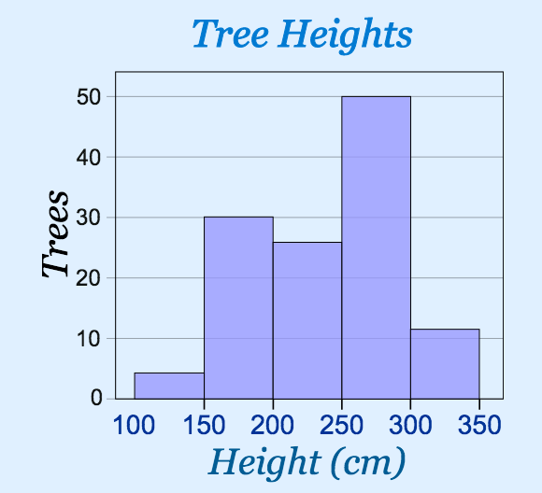
Histogram and Binnings
The height of each bar shows how many fall into each range.
And you decide what ranges to use!

Slide 20
Histogram and Binnings
Example: Height of Orange Trees
You measure the height of every tree in the orchard in centimeters (cm)
The heights vary from 100 cm to 340 cm
You decide to put the results into groups of 50 cm:
The 100 to just below 150 cm range,
The 150 to just below 200 cm range,
etc...

Slide 21
Histogram and Binnings
And here is the result:
You can see (for example) that there are 30 trees from 150 cm to just below 200 cm tall
a tree that is 260 cm tall is added to the "250-300" range.

Slide 22
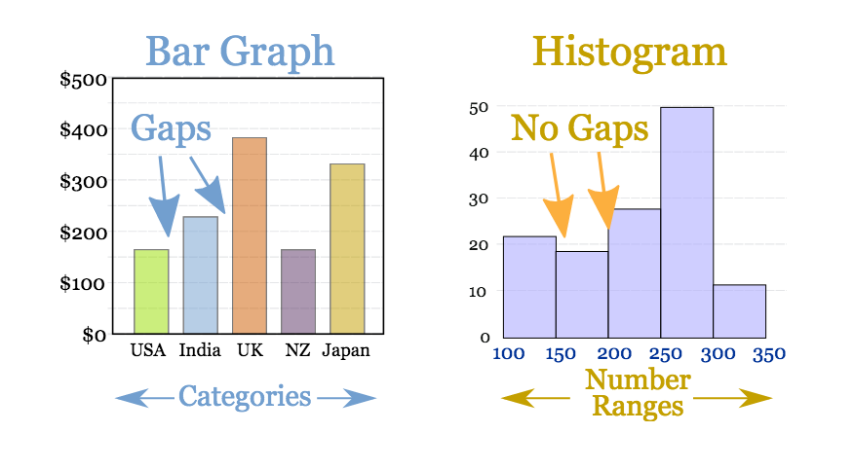
Bar vs Histogram
Plot: 2 data
Plot: 1 data
Y values
Frequency

Slide 23
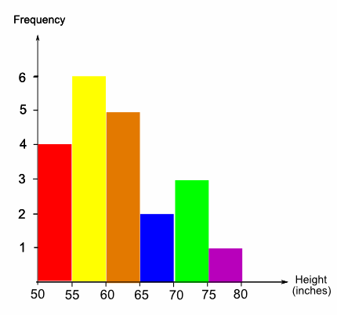
Let’s read a histogram
The histogram shows the heights of 21 students in a class, grouped into 5-inch groups. How many students were greater than or equal to 60 inches tall?

Slide 24
Create histogram using plt.hist()
mu, sigma = 100, 15
x = mu + sigma * np.random.randn(10000)
# the histogram of the data
n, bins, patches = plt.hist(x, 50, normed=1, facecolor='g', alpha=0.75)
plt.xlabel('Smarts')
plt.ylabel('Probability')
plt.title('Histogram of IQ')
plt.text(60, .025, r'$\mu=100,\ \sigma=15$')
plt.axis([40, 160, 0, 0.03])
plt.grid(True) #to show the grid
#to highlight special patches
plt.setp(patches[25:30],'facecolor','r')
n: is the number of counts in each bin of the histogram
bins: is the left hand edge of each bin
patches: is the individual patches used to create the histogram, e.g a collection of rectangles

Slide 25
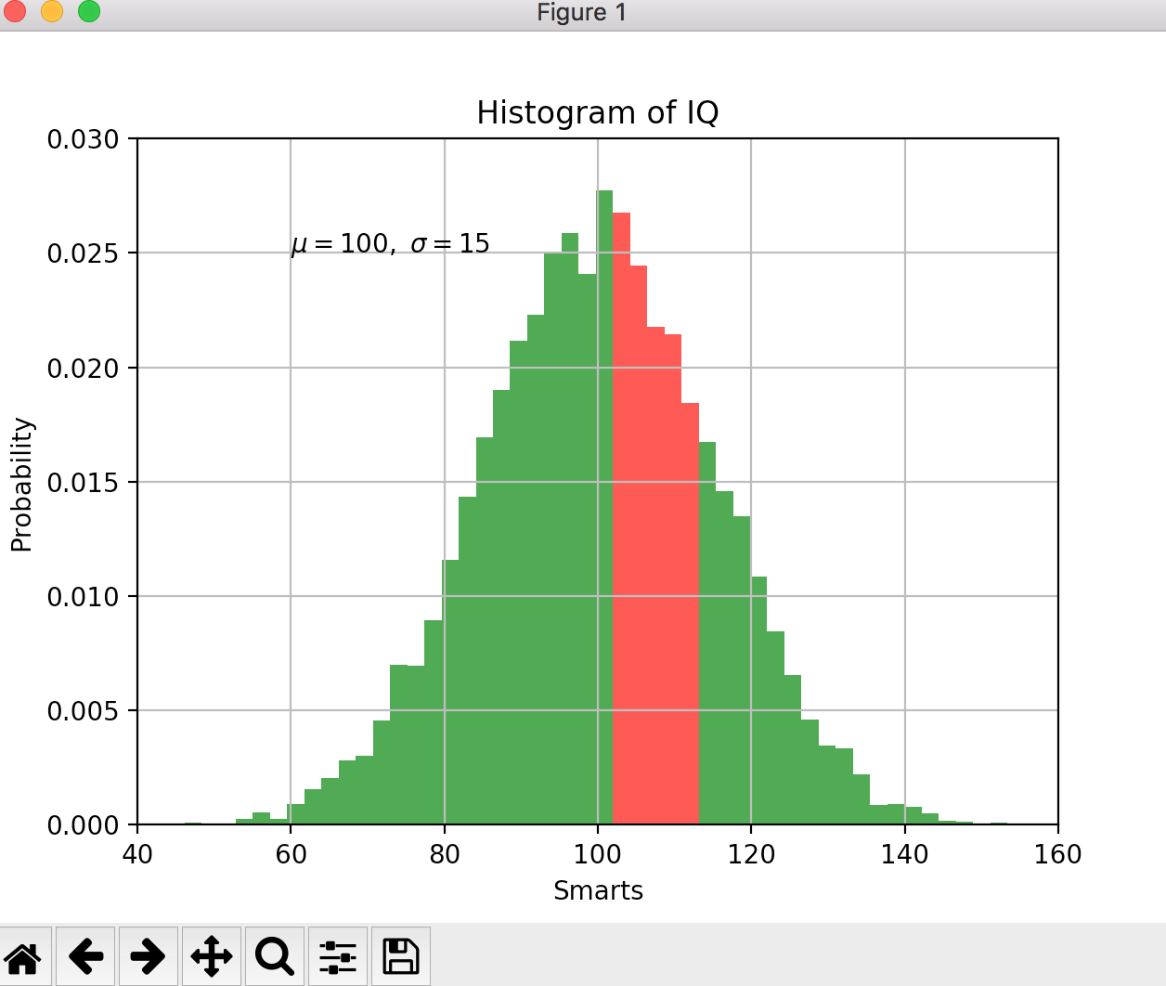
Create histogram using plt.hist()
mu, sigma = 100, 15
x = mu + sigma * np.random.randn(10000)
# the histogram of the data
n, bins, patches = plt.hist(x, 50, normed=1, facecolor='g', alpha=0.75)
plt.xlabel('Smarts')
plt.ylabel('Probability')
plt.title('Histogram of IQ')
plt.text(60, .025, r'$\mu=100,\ \sigma=15$')
plt.axis([40, 160, 0, 0.03])
plt.grid(True) #to show the grid
#to highlight special patches
plt.setp(patches[25:30],'facecolor','r')

Slide 26
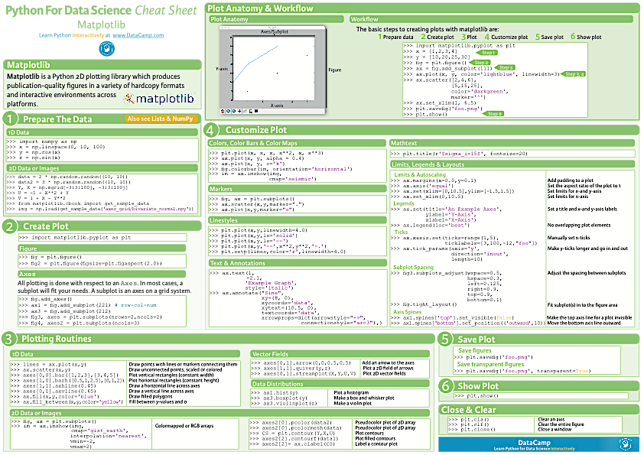

Slide 27
Your exercise
From automobile.csv data, please create the pretty visualization of the following:
Number of cars produced by each car maker company in a bar chart
The histogram of the car prices
(the hist() doesn’t recognize NaN, so you must clean your data first)
Length vs wheel base in scatter chart
HINT: you can use tolist() to convert table data to list

Slide 28
Link to DATASET
http://bit.ly/dataset_compmath

Slide 29
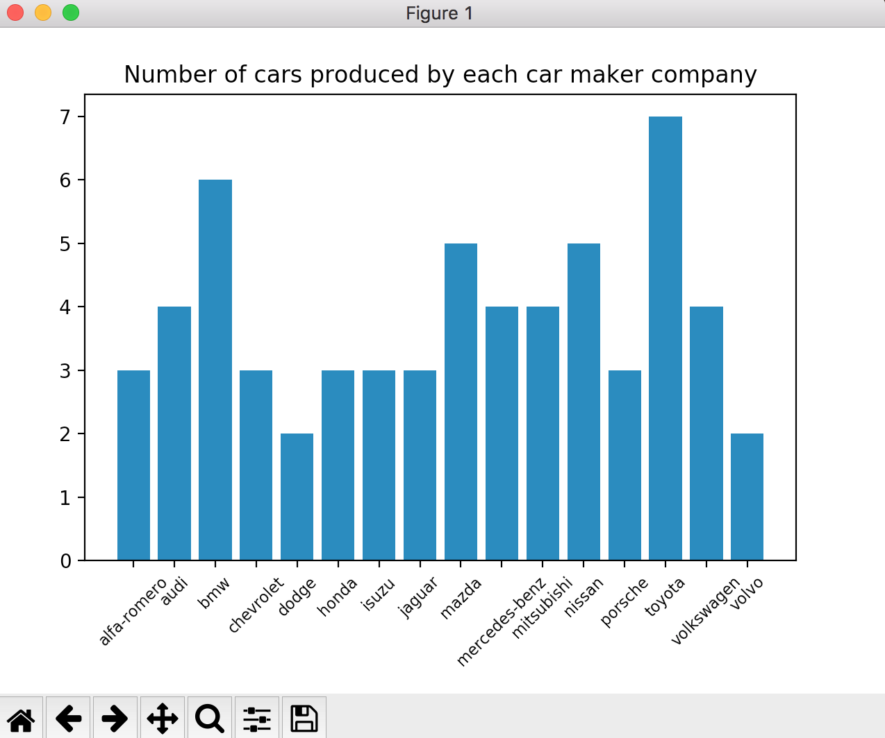
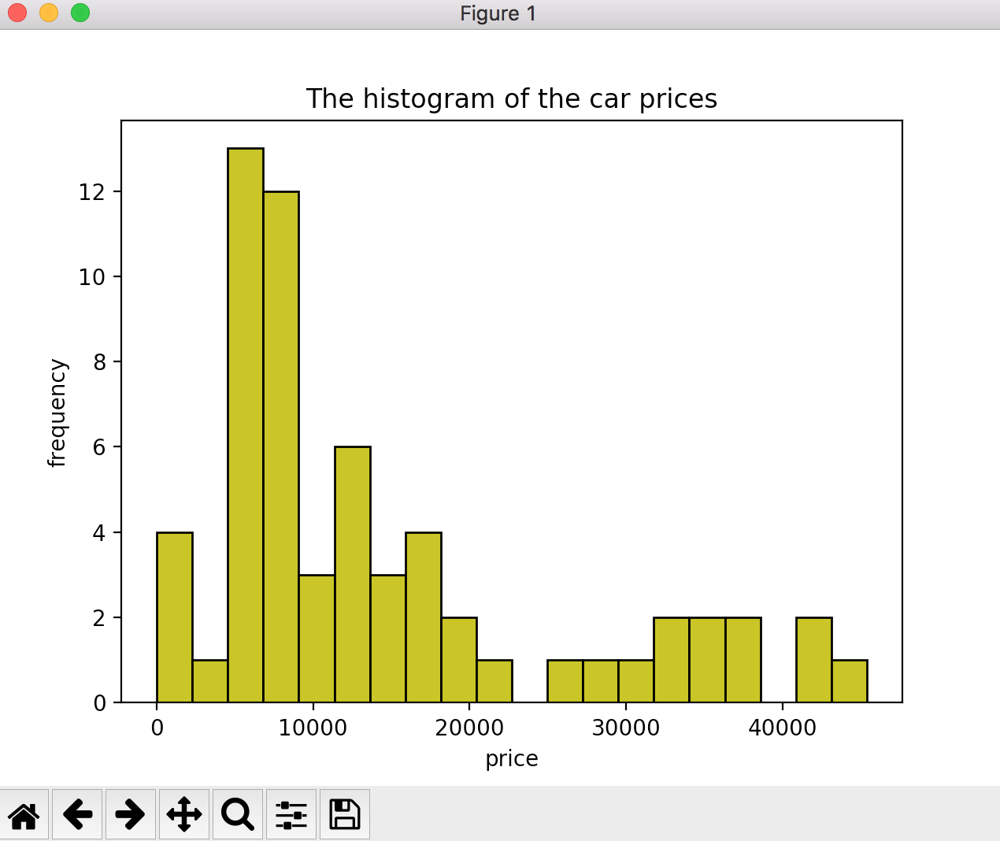
The graphs

Slide 30
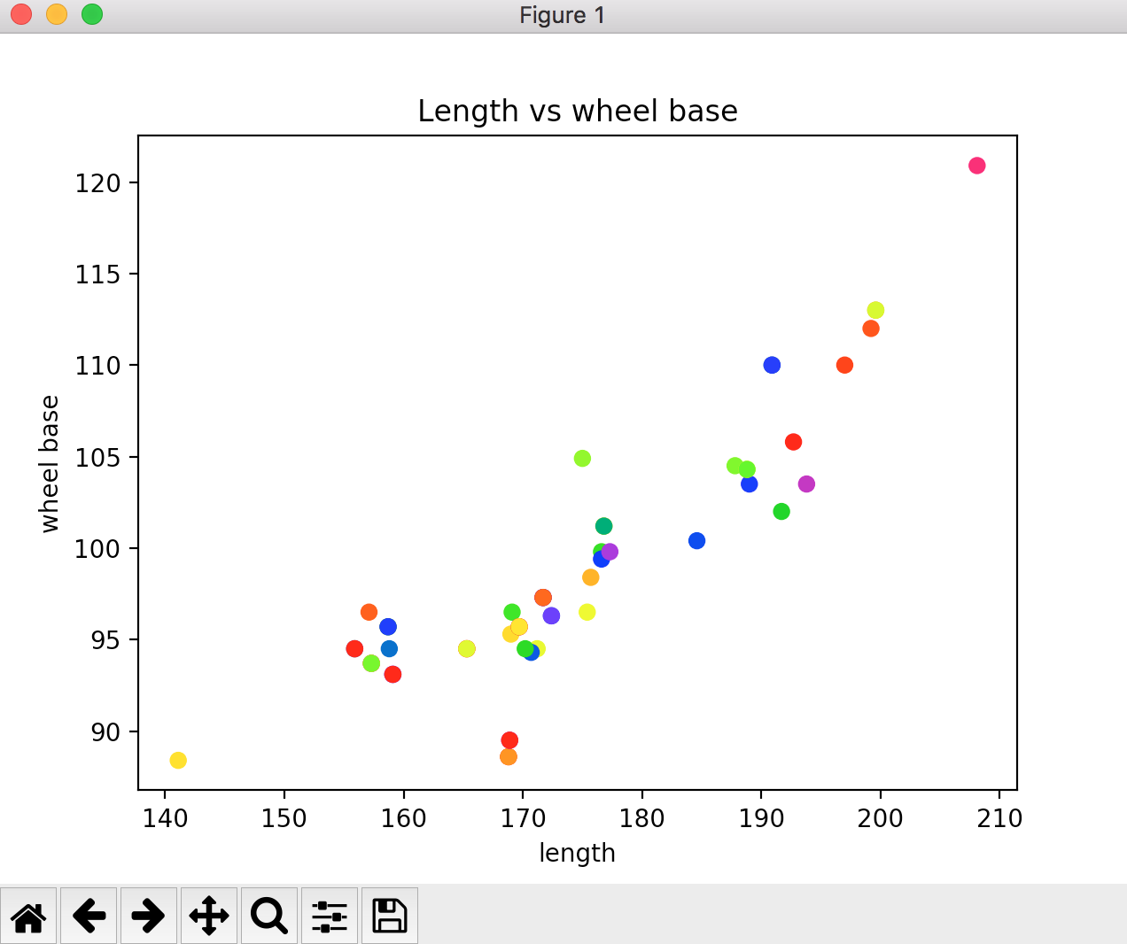
The graphs

